Slide 1
SAP Material Management

Slide 2
Agenda
Overview Of Material Management
Procure to Pay Process
Purchase Requisition
Purchase order
Goods Receipt
Invoice Receipt
Organization structure
Master Data
Material Master
Vendor Master
Source list
Info Record
Important Tables

Slide 3
Over view of Material management
SAP MM (Material Management) is one of the vital modules in SAP ERP software and MM module supports the procurement and inventory functions occurring in day-to-day business operations.
This MM module consists of many facets such as purchasing, goods getting, material storage, consumption-based planning, and inventory.
SAP MM module is completely integrated with other modules in the SAP R/3 System such as Finance (FI), Controlling (CO), Sales and Distribution (SD), Quality Management (QM), Plant Maintenance (PM), Production Planning (PP), and Warehouse Management(WM).

Slide 4
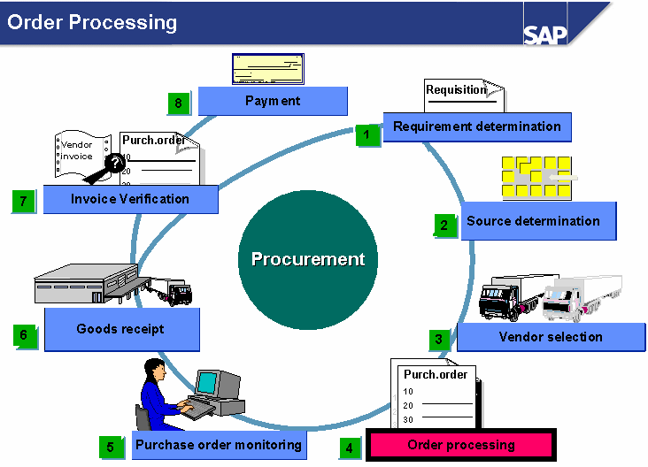
Procure To Pay Process

Slide 5
Determination of requirements

Slide 6
Purchase requisitions
Purchase requisitions are internal documents you use to request your Purchasing department to procure a particular quantity of a material or a service for a particular date.
Purchase requisitions are either created manually by the department responsible for automatically by MRP.
Purchasing converts the purchase requisition into a request for quotation

Slide 8
Request for Quotation
After establishing that a material or service is required, the Purchasing department needs to convert the purchase requisition into a purchase order. The R/3 System can support the Purchasing department using the requests for quotation in the source determination.
First, you enter a request for quotation for the relevant material or the required service.
The system determines the address from the data in the respective vendor master record.

Slide 10
Purchase Order
A purchase order is a formal request to a vendor to supply certain goods or services under the stated conditions.
You can create purchase orders without reference, or with reference to a purchase requisition, a request for quotation, or another purchase order.

Slide 12
Goods Receipt
Posting a goods receipt to stock with reference to a purchase order has a number of advantages for you, including:
The goods receiving point can check whether the delivery is the same as the purchase order data, that is, whether the goods that were ordered have been delivered.
The system suggests data from the purchase order when you enter the goods receipt

Slide 13
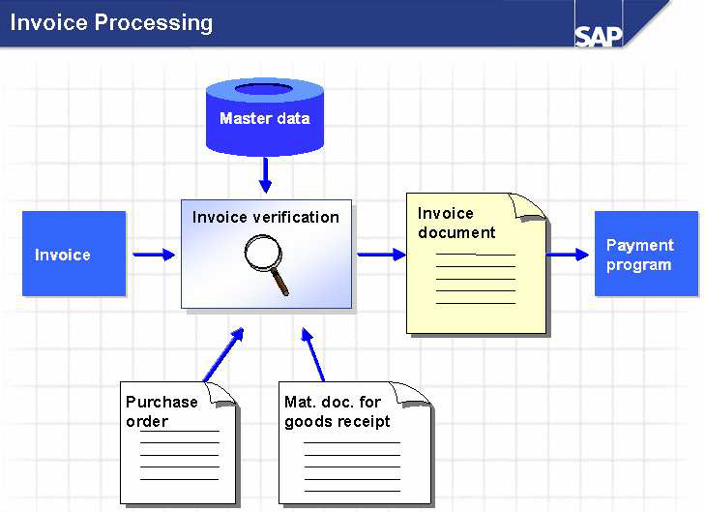

Slide 14
Invoice Verification
When you enter an invoice with reference to a purchase order, the system suggests data from the purchase order and the goods receipts for the purchase order (for example, vendor, material, quantity still to be invoiced, terms of payment, and so on).
If there are discrepancies between the purchase order or goods receipt and the invoice, the system warns the user, and depending on how the system is configured, blocks the invoice for payment.
The posting of the invoice completes the invoice verification process. The system updates the purchase order history and Financial Accounting initiates payment for the open invoice items.
Invoice Verification creates a link between Materials Management and external or internal accounting.

Slide 15
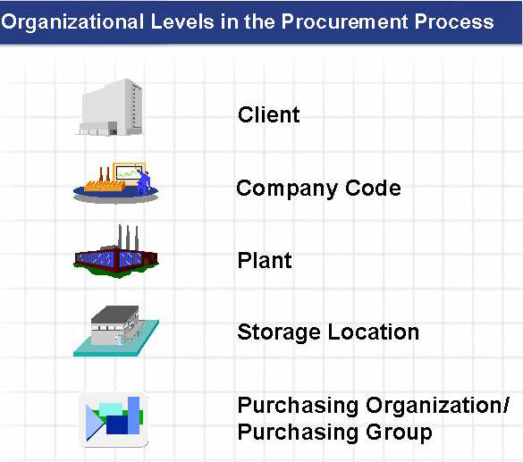
Material management
Organization structure

Slide 20
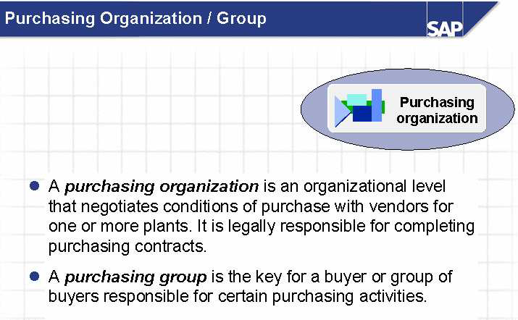

Slide 21
MASTER DATA
Material Master
Vendor Master
Source list
Purchase Info Record

Slide 22
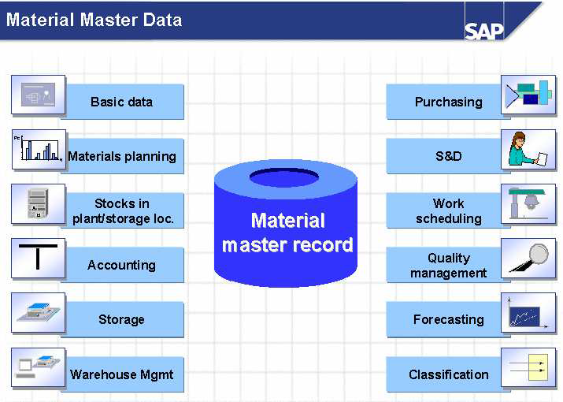
MATERIAL MASTER DATA

Slide 23
Material master
The record contains description of all articles and parts that an enterprise procures, manufactures and stores.
This is the central repository of material specific information. The data MMR can be used by purchasing dept. and other areas like IM,MRP and IV.
The data is stored in individual views.

Slide 24
VENDOR MASTER
The Vendor master record contains information on an enterprise vendors. The vendor is a creditor of an enterprise.
The existence of a Vendor master record is a necessary for creation of an external purchasing docs. (RFQ,PO,O/L).
The VM can be maintained either centrally or locally.

Slide 25
VM
GENERAL DATA
Address,Tel.no,Language etc.
COMPANY CODE DATA
Payment Transactions, A/c info.
Etc.
PURCHASING DATA
Currency,Terms of Payments
Control indicators,
Partner functions etc.
25
2/5/2020

Slide 26
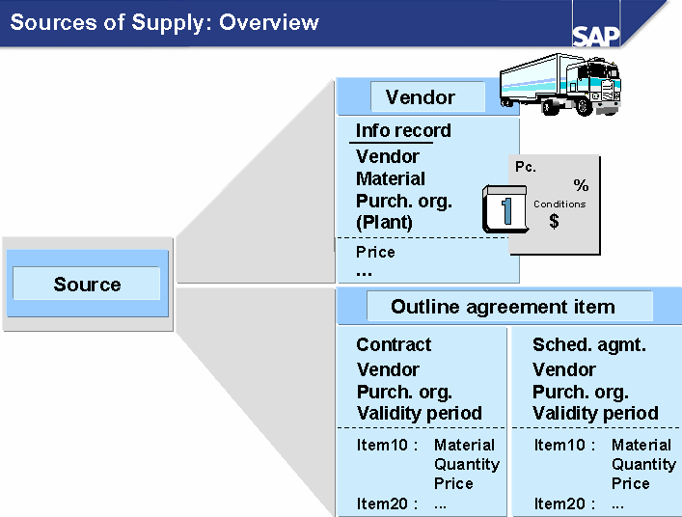
Source Determination

Slide 27
SOURCE LIST
The purpose of source determination process is to automatically assign a source of supply to a purchase requisition. This contains a list of sources for a material in a particular plant and for particular time periods.
The source list has the following purposes.
1.Restricting the selection of sources during the source determination process.
2.Defining the source as a fixed source.
3.Blocking a source
4.MRP indicator i.e to find this source in planning.

Slide 28
PURCHASE INFO RECORD(PIR)
The PIR provides the option of storing information about a vendor and a material as the master data at purchase organisation and plant level. The following information can be defined in PIR.
Current and future prices and conditions fright, discount
Delivery data i.e planned del. Time, over and under tolerances
vendor data and vendor specific data about material.
Number of last purchase order.

Slide 29
PIR
GENERAL DATA
VENDOR DATA
ORDER UNIT
ADMINISTATIVE DATA
PURCHASING ORG DATA
CONTROL
PRICES
TEXTS
PURCHASE ORG/PALNT DATA
CONTROL
PRICES
TEXT
29
2/5/2020

Slide 30
Important Tables
MARA | Material Master: General data
MARC | Material master: Plant data
MARD | Material master: Storage location
LFA1 | Vendor Master: General data
LFB1 | Vendor Master: Company data
LFM1 | VM Purchasing Data
EKKO | Purchasing document header
EKPO | Purchasing Document: Item
EINA | Purchase Info Record: General
EINE | PIR: purchasing organization data
KONP | Condition Item
KONH | Condition Header
EORD | Purchasing Source List

Slide 31
Thank you

